Slide 1
Information Security
Chapter 1&2
BS-CS-VI
VVEEK-02 & 03 Lectures

Slide 2
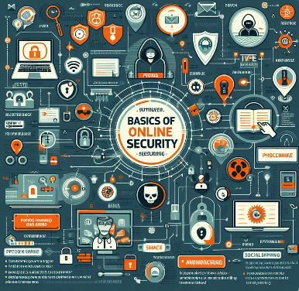
🔐 Basic Security Terminology
Information Security
Confidentiality
Integrity
Availability
Authentication Verifying the identity of a user.
Authorization Granting permission to access
Malware Malicious software designed to harm systems.
Virus A program that attaches itself to files and spreads when executed.
Worm A self-replicating malware that spreads without user action.
Encryption Converting data into unreadable form to protect it.
Audit Trail / Log A record of system activities for monitoring and investigation.
Backup A copy of data stored to prevent data loss.

Slide 3
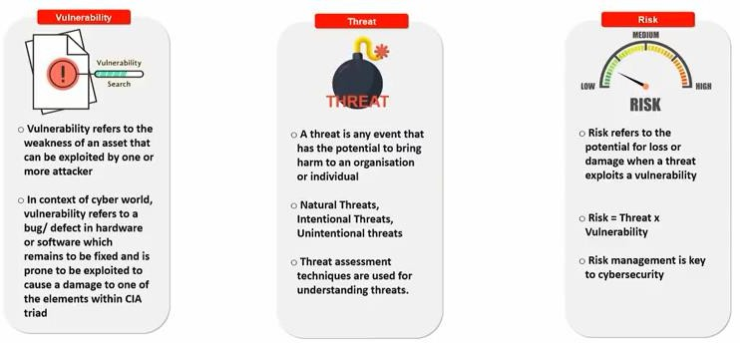
Vulnerability, Threat & Risk
3

Slide 4
C.I.A. triangle or Security Objectives
Confidentiality
  “Preserving authorized restriction on information access and disclosure, including means for protecting personal privacy and proprietary information.”
Integrity
  “Guarding against improper information modification or destruction, and includes ensuring information non-repudiation and authenticity.”
Availability
  “Ensuring timely and reliable access and use of information.”
- 4 -

Slide 5
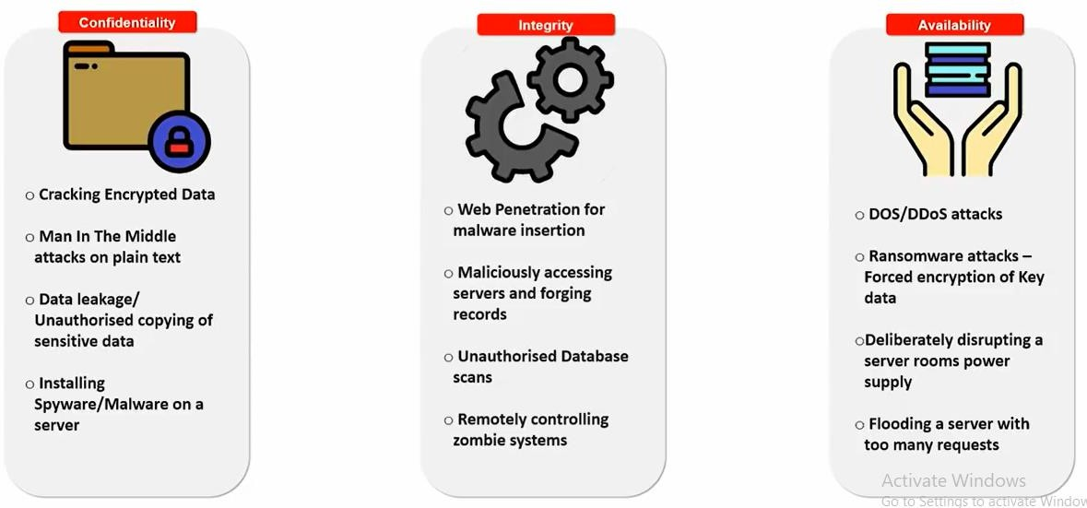
Attacks on CIA
DoS (Denial of Service) attacks overwhelm a system with excessive requests from a single source, while DDoS (Distributed Denial of Service) attacks originate from multiple compromised devices, making them harder to mitigate.
Spyware and Malware are both types of malicious software that can harm computers, networks, and user data. Malware is broad term for any software designed to damage, disrupt, or gain unauthorized access to systems.
Spyware is a type of malware that secretly gathers information about a user’s activities without their knowledge. It can track keystrokes, browsing history, login credentials, and personal data.
5

Slide 6
CIA TRIAD (Video)
https://www.youtube.com/watch?v=inWWhr5tnEA&list=PLEiEAq2VkUUJfPOj5nRounXvf3n17PCft
https://www.youtube.com/watch?v=rwigKjEsdTc
- 6 -

Slide 7
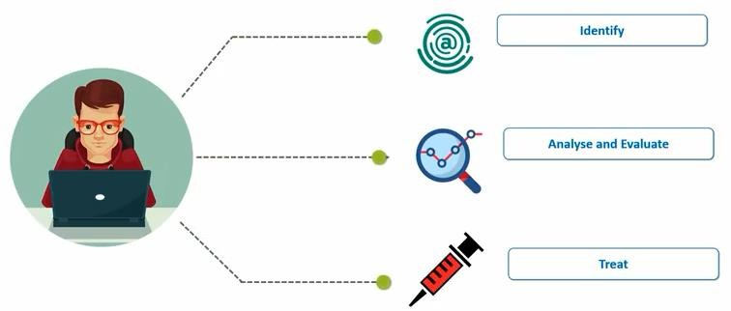
Steps to Fix a Crime

Slide 8
How Seriously Should You Take Threats to Network Security?
Which group do you belong to?
  “No one is coming after my computer.”
  “The sky is falling!”
  Middle ground.

Slide 9
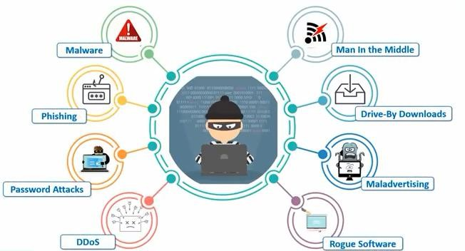
Cyber Attacks
1.Phishing – Fraudulent attempts to steal sensitive information via fake emails or websites. (e.g., Spear Phishing, Email Scams)
2.Password Attack – Unauthorized access attempts using stolen or guessed passwords. (e.g., Brute Force, Credential Stuffing)
3.Malvertising & Rogue Software – Fake ads or software that deliver malware. (e.g., Fake Antivirus, Pop-up Scams)

Slide 10
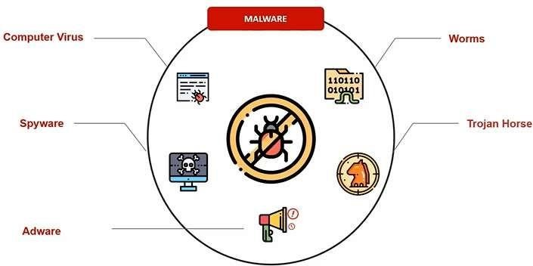
Malware
Malicious software disguised as legitimate to trick users into installing it.
Malicious software disguised as legitimate to trick users into installing it.
Key Difference: Trojans require user action to execute, while worms spread autonomously.

Slide 11
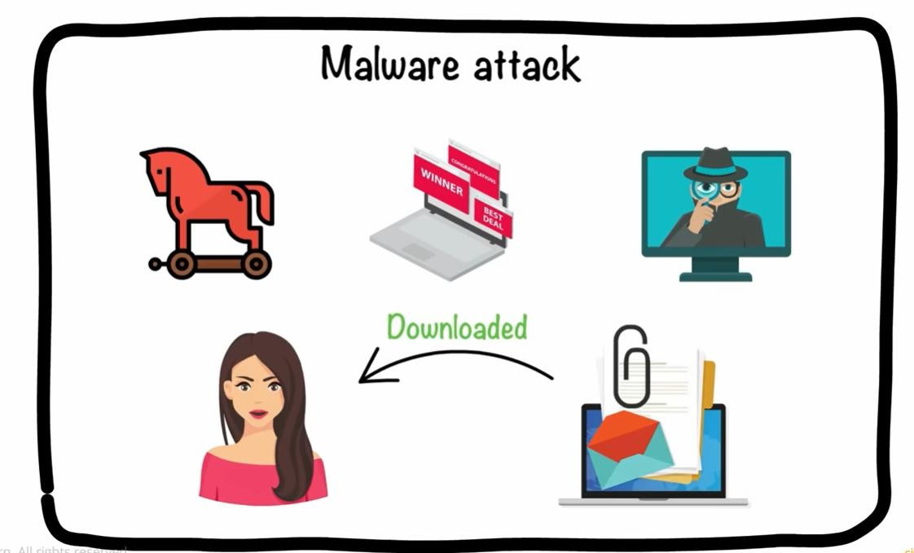

Slide 12
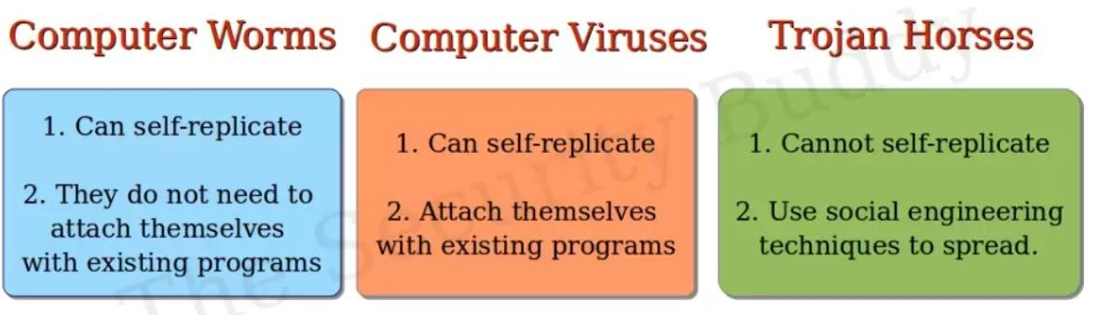

Slide 13
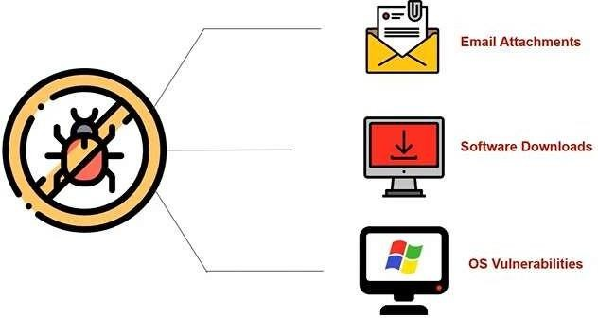
How Malware

Slide 14
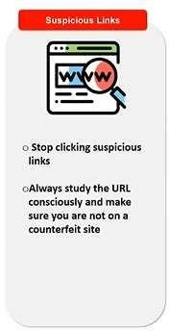
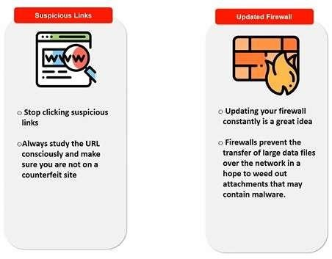
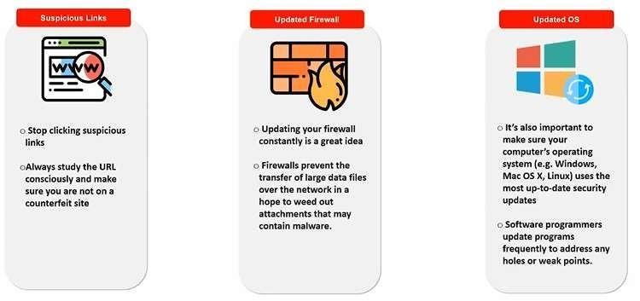
How to Stop?

Slide 15
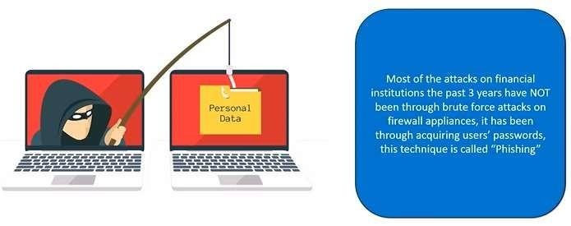
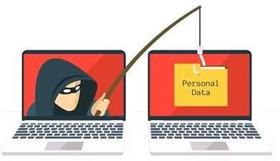
Phishing Attack
https://www.youtube.com/watch?v=XBkzBrXlle0&list=PLEiEAq2VkUUJfPOj5nRounXvf3n17PCft&index=3

Slide 16
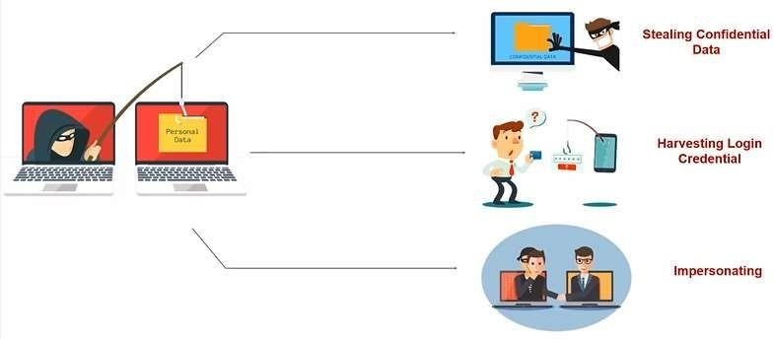
What is Phishing used for?
40

Slide 17
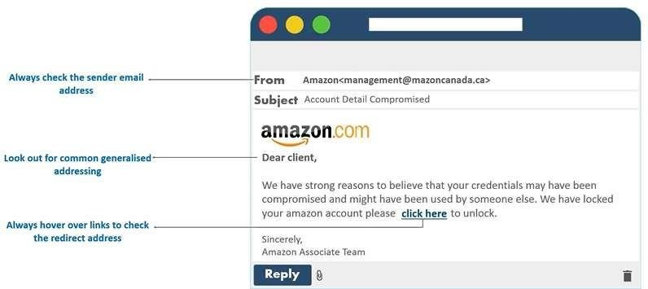
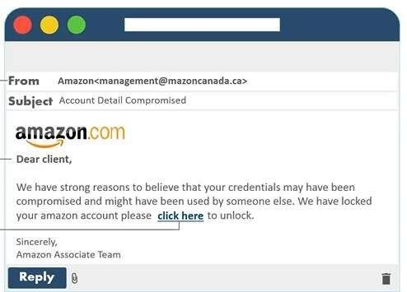
Phishing Awareness

Slide 18
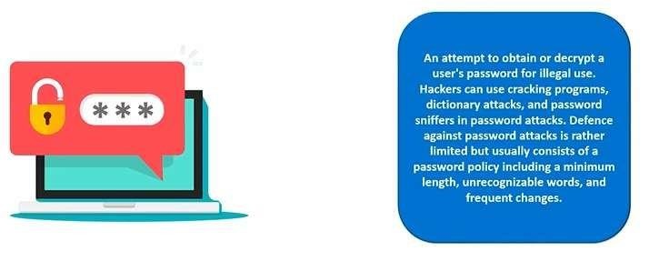
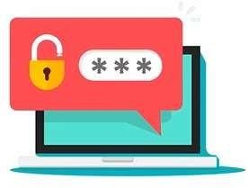
Password Attacks

Slide 19
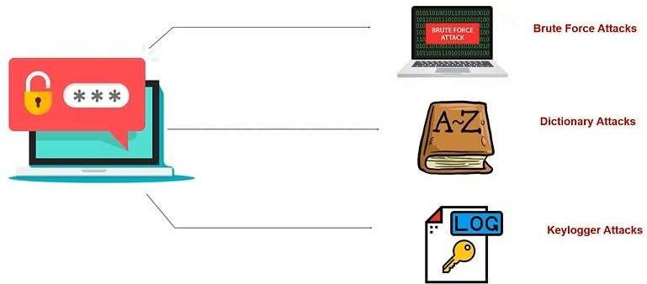
Types of Password Attacks
A Brute Force Attack is a hacking method where attackers systematically try all possible passwords or encryption keys until they find the correct one.
How It Works:
Repeated login attempts using trial-and-error.
Automated tools generate and test millions of combinations.
Targets weak passwords and unprotected systems.
🔹 Examples:
Dictionary Attack – Using a list of common passwords.

Slide 20
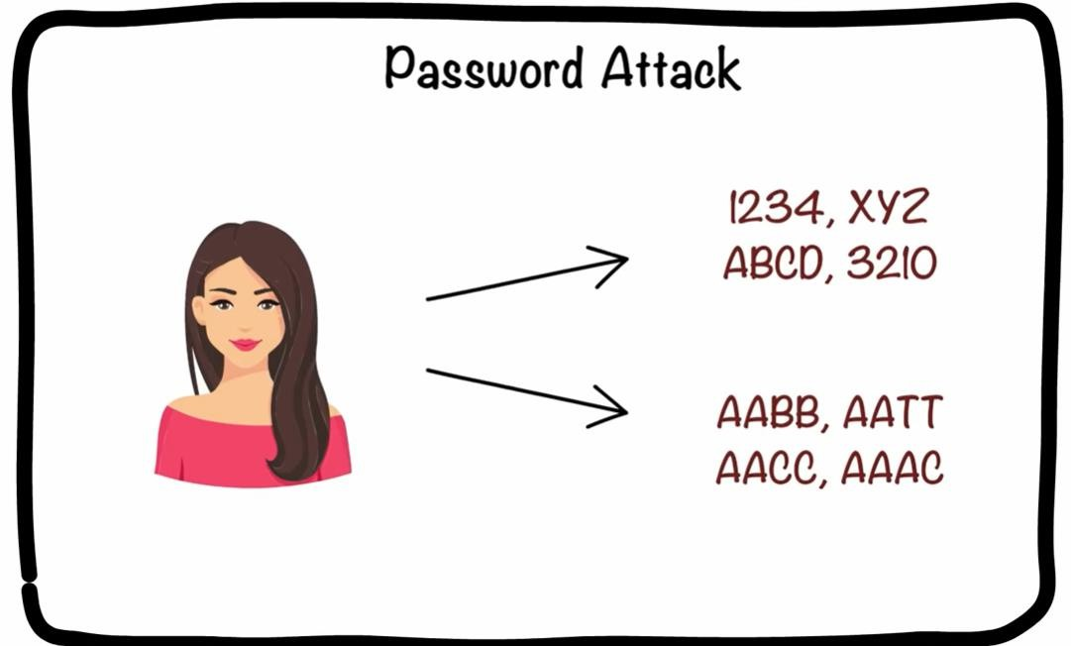

Slide 21
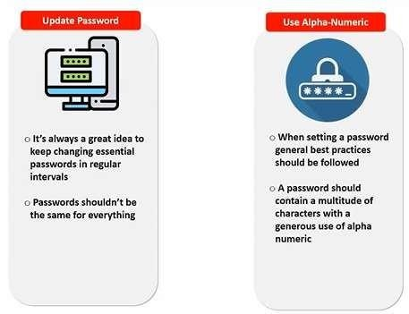
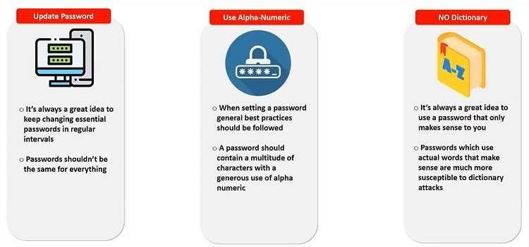
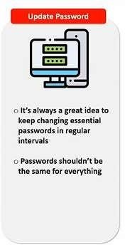
Stop Password Attacks

Slide 22
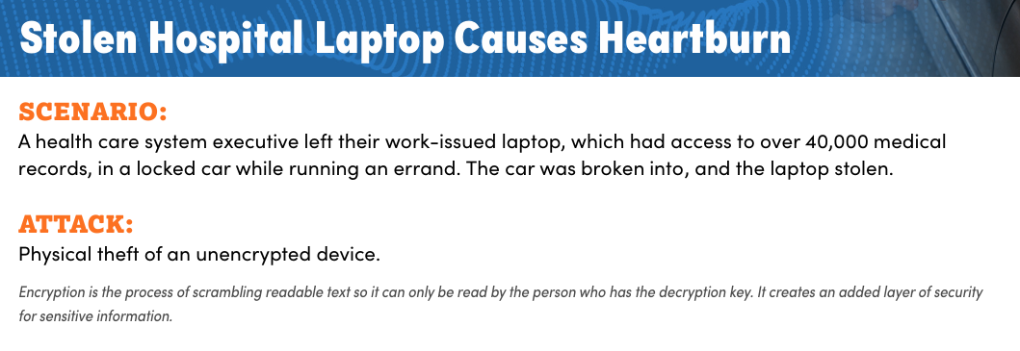
Class Activity

Slide 23
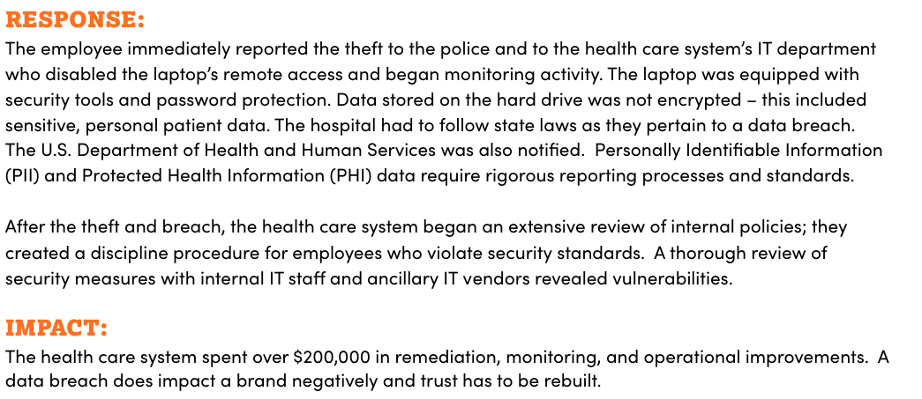
Solution

Slide 24
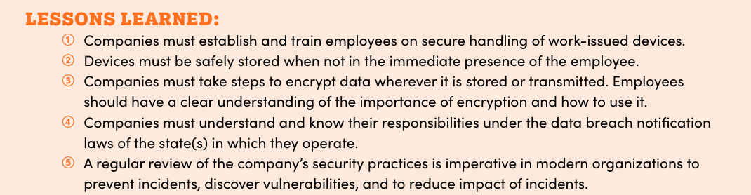

Slide 25
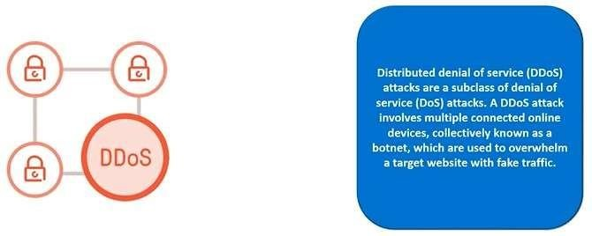
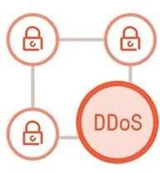
Distributed Denial of Services (DDoS)

Slide 26

Denial of Service Attacks
The attacker does not intrude into the system but just blocks access by authorized users.
55

Slide 27
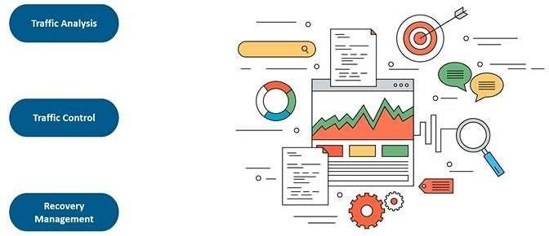
Prevention

Slide 28
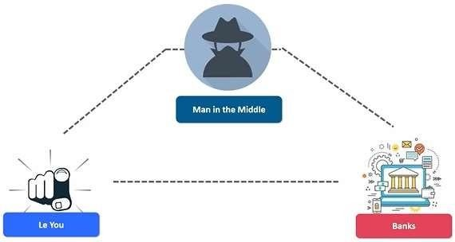
Man in the Middle

Slide 29
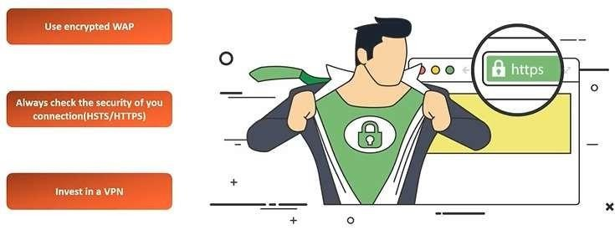
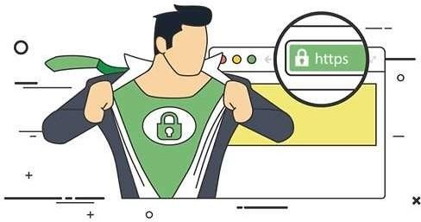
Prevent MITM
Wireless Application Protocol)

Slide 30
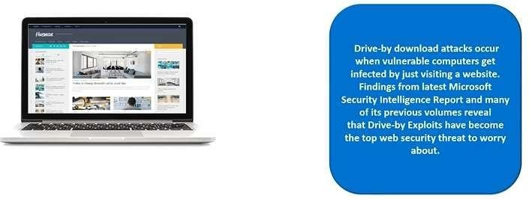
Drive-by Download
50

Slide 31
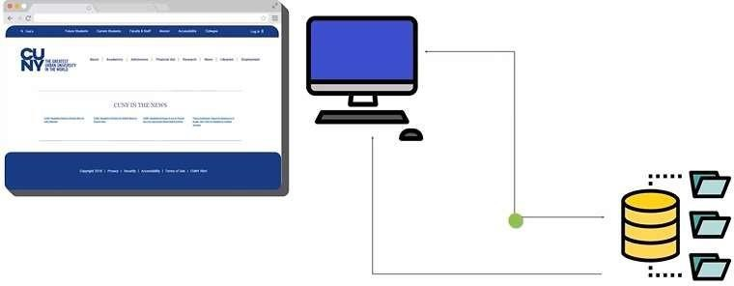
How it work?

Slide 32
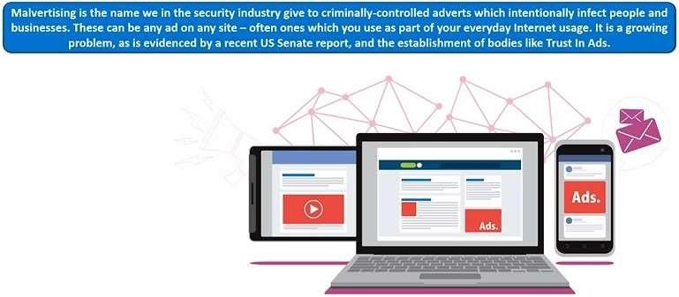
Malvertising

Slide 33
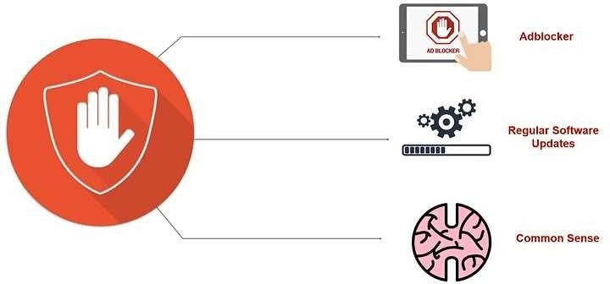
Prevention

Slide 34
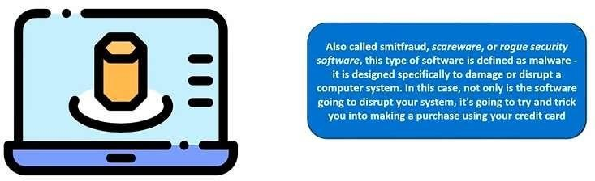
Rogue Software

Slide 35
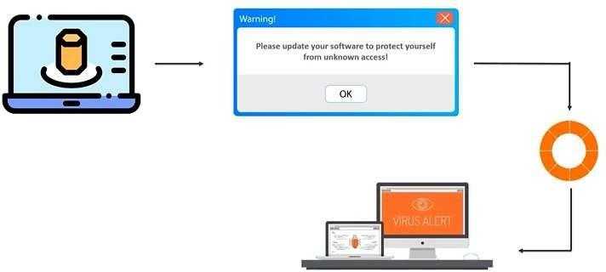
Propagation
Propagation refers to the process of spreading, transmitting, or distributing something, depending on the context.
🔹 Common Uses of Propagation:
Network & Malware Propagation – The way viruses, worms, and malware spread across systems. (e.g., Email Worms, USB Infections)

Slide 36
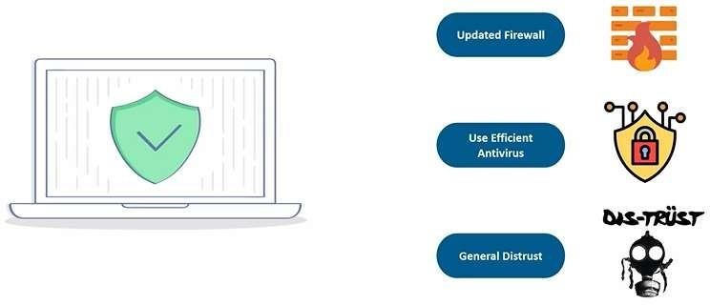
Prevention

Slide 37
Web Attacks
The attacker attempts to breach a web application. Common attacks of this type are SQL injection
67

Slide 38
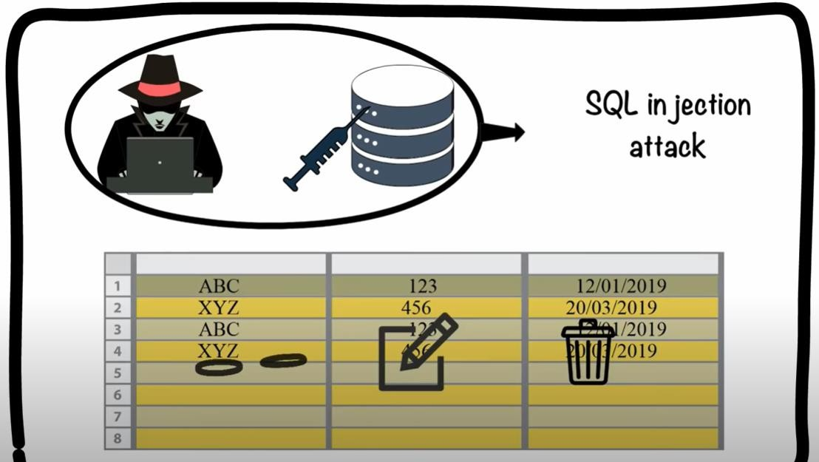

Slide 39
Session Hijacking
This is a complex attack that involves actually taking over an authenticated session.
39

Slide 40
DNS Poisoning
This involves altering DNS records on a DNS server to redirect client traffic to malicious websites, usually for identity theft.
40

Slide 41
Cyber Crime?
????
Cybercrime, or computer-oriented crime, is a crime that involves a computer and a network. The computer may have been used source of a crime, or it may be the target.

Slide 42
Classification of Cyber Crimes
Insider Attack:
  Person with authorized system access
  Dissatisfied or unhappy inside employees or contractors
  Motive could be revenge or greed
  Well aware of the policies, processes, IT architecture and weakness of the security system
  Comparatively easy for a insider attacker to steel sensitive information, crash the network, etc.
  Could be prevented by using IDS/IPS (IDS (Intrusion Detection & Prevention System)
External Attack:
  Hired by an insider or an external entity to the organization
  Organization not only faces financial loss but also the loss of reputation
  Attackers usually scan and gathering information
  Keeps regular eye on the log and carefully analyzing these firewall logs
  IDS/IPS can also protect from external attackers

Slide 43
Classification of Cyber Crimes (Cont.)
Cyber attacks can also be classified as:
  Unstructured attacks
    Generally person who don't have any predefined motives to perform the cyber attack
    Try to test a tool readily available over the internet
  Structure attacks:
    Performed by highly skilled and experienced people
    Motives of these attacks are clear in their mind
    Access to sophisticated tools and technologies to gain access to other networks without being noticed
    Expertise to develop or modify the existing tools to satisfy their purpose
    Usually performed by professional criminals, by a country on other rival countries, politicians to damage the image of the rival person or the country, terrorists, rival companies, etc.
60

Slide 44
Reasons for Commission of Cyber Crimes
Money:
  People are motivated towards committing cyber crime is to make quick and easy money.
Revenge:
  Take revenge with other person/organization/society/caste or religion
  Defaming its reputation or bringing economical or physical loss.
  This comes under the category of cyber terrorism.
Fun:
  The amateur do cyber crime for fun.
Recognition:
  It is considered to be pride if someone hack the highly secured networks
Anonymity:
  Anonymity that a cyber space provide motivates the person to commit cyber crime
Cyber Espionage:
  At times the government itself is involved in cyber trespassing to keep eye on other person/network/country

Slide 45
Kinds of Cyber Crimes
Cyber Stalking
  Stalking, harassing, threatening someone, or defame a person
  The behavior includes false accusations, threats, sexual exploitation to minors, monitoring, etc.
Child Pornography
  Possessing image or video of a minor (under 18), engaged in sexual conduct.
Forgery and Counterfeiting
  Produce counterfeit which matches the original document
  Not possible to judge the authenticity of the document
Software Piracy and Crime related to IPRs: (Intellectual Property Rights)
  An illegal reproduction and distribution
Cyber Terrorism
  Use of computer resources to intimidate or force government, the civilian population or any segment thereof in furtherance of political or social objectives
Phishing
  Acquiring personal and sensitive information of an individual via email
  Vishing (voice phishing), Smishing
■

Slide 46
Kinds of Cyber Crimes (Cont.)
Computer Vandalism
  Physical destroying computing resources using physical force or malicious code
Computer Hacking
  Modifying computer hardware and software to accomplish a goal
  Simply demonstrations of the technical ability, to sealing, modifying or destroying information for social, economic or political reasons

Slide 47
Kinds of Cyber Crimes (Cont.)
Creating and distributing viruses over internet
  Spreading of an virus can cause business and financial loss
Spamming
  Sending of unsolicited and commercial bulk message
  Spams not only irritate the recipients and overload the network but also waste the time and occupy the valuable memory space
Cross Site Scripting
  Injecting a malicious client side script into a trusted website
  Malicious script gets access to the cookies and other sensitive information and sent to remote servers
Online Auction Fraud
  Online auction fraud schemes which often lead to either overpayment of the product or the item is never delivered
Cyber Squatting
  Reserving the domain names of someone else's trademark
  Sell it afterwards at higher price
■

Slide 48

Basic Security Terminology
Hackers (General Term) 🖥️
A hacker is someone skilled in computer programming, networking, and security, who can exploit or protect systems. Hackers can be ethical or malicious.
White Hat Hackers (Ethical Hackers)
Work legally to test and improve cybersecurity.
Help organizations by finding and fixing vulnerabilities.
Often hired as penetration testers or security experts.
Example: Ethical hackers working for companies like Google or Microsoft.
Black Hat Hackers (Malicious Hackers)
Break into systems illegally for personal gain, destruction, or espionage.
Involve in data theft, malware attacks, and financial fraud.
Example: Cybercriminals launching ransomware attacks.
Gray Hat Hackers (Neutral Hackers)
Operate between white hat and black hat ethics.
Find vulnerabilities without permission but often report them instead of exploiting them.
May still break laws but not always for harmful intent.
Example: A hacker discovering a system flaw and notifying the company without prior approval.
Script Kiddies (Unskilled Hackers)
Use pre-made hacking tools and scripts without deep technical knowledge.
Often hack for fun, fame, or minor attacks like defacing websites or running small-scale DDoS attacks.
Example: A teenager using a hacking tool to break into a school’s system.
People:
Hackers
  White hats
  Black hats
  Gray hats
Script kiddies
Ethical hackers/Sneakers
48

Slide 49
Network Security Paradigms
How will you protect your network?
  CIA Triangle
  Least Privileges
  Perimeter security approach
  Layered security approach
  Proactive versus reactive
  Hybrid security method
49

Slide 50
Compromises to Intellectual Property
Definition: The unauthorized use, theft, or copying of creations of the mind—like software code, business plans, designs, or trade secrets.
Simple Logic: If you spent 5 years and $1 million developing a secret recipe or software, and someone copies it in 5 seconds for free, your investment is destroyed.
Real-Time Example:
Scenario: Imagine "Cool Soda Co." has a secret, unique formula that makes their drink fizz perfectly. A disgruntled employee emails the formula to "Cheap Soda Inc."
What Happens? Cheap Soda Inc. now makes an identical drink without any of the research cost. They sell it cheaper, stealing Cool Soda's customers and profits.
The Real-World Version: This is what happens when a company's proprietary source code, chemical formula, or manufacturing process is hacked or leaked. It undermines innovation and competitive advantage.

Slide 51
Deviations in Quality of Service
Definition: An attack that disrupts the normal, expected availability of a digital service or resource.
Simple Logic: It's not about stealing the highway; it's about creating a massive traffic jam so no one can use it.
Real-Time Example:
Scenario: It's the day before final exam results are posted. The university's student portal usually gets 1,000 students logging in per hour.
The Attack: A hacker sends 1,000,000 fake login requests from a network of infected computers (a "botnet") to the portal server.
What Happens? The server is overwhelmed by the fake traffic. It crashes or becomes incredibly slow. Legitimate students (and staff) cannot access their grades. The service's quality has catastrophically "deviated" from its normal function. This is called a Denial-of-Service (DoS) attack.

Slide 52
Espionage or Trespass
Definition: The unauthorized access to a system or network to gather confidential information or simply to see what's there.
Simple Logic: It's a digital "break and enter." The goal isn't to vandalize (yet), but to sneak in, look through private files, and take pictures of secrets.
Real-Time Example:
Scenario: A nation-state wants details of another country's new fighter jet design. The designs are on a secured, air-gapped network at a defense contractor.
The Attack: Hackers send a "spear-phishing" email to an engineer. The email looks real, with a link about a required "HR policy update." The engineer clicks it, unknowingly installing spyware.
What Happens? The spyware secretly records the engineer's keystrokes and sends screenshots of the jet designs back to the attackers. This is cyber-espionage. The trespass occurred the moment the malware bypassed security and entered the network.

Slide 53
Cyber Stalking
Definition: The use of the internet or other electronic means to stalk, harass, or threaten an individual, group, or organization.
Simple Logic: It's traditional stalking, supercharged by technology. Constant, unwanted attention that invades your digital and real-world life, creating fear.
Real-Time Example:
Scenario: After a brief online disagreement in a forum, a user becomes fixated on you.
The Behavior: They create fake social media profiles to follow you. They use information from your public posts to find your home address and workplace. They send you dozens of threatening emails daily. They might even use GPS tagging on photos you post to track your movements.
What Happens? You feel unsafe in your own home. Your online life, which should be a space for connection, becomes a source of terror. This is a persistent, malicious invasion of privacy with real psychological consequences.

Slide 54
How Do Legal Issues Impact Network Security?
The Computer Security Act of 1987
OMB Circular A-130
See www.alw.nih.gov/Security/FIRST/papers/ legal/statelaw.txt for state computer laws
Health Insurance Portability and Accountability Act of 1996, HIPAA
54

Slide 55
Online Security Resources
CERT
  www.cert.org
Microsoft Security Advisor
  www.microsoft.com/security/default.mspx
F-Secure
  www.f-secure.com
SANS
  www.sans.org
55

